Slide 1

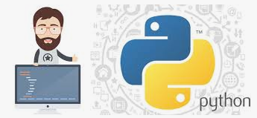
Python application Programming
Dept. of CS&E, MSRIT

Slide 2
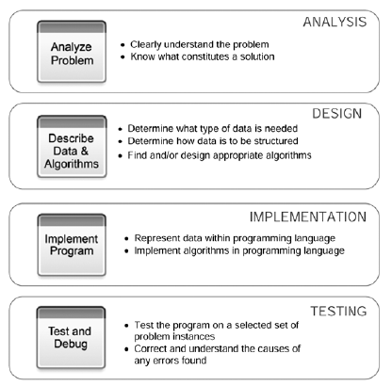
Computational Problem Solving
Dept. of CS&E, MSRIT

Slide 3
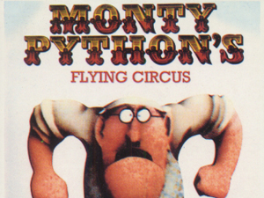
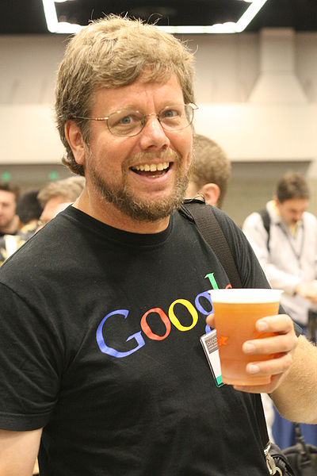
Brief History of Python
Guido van Rossum
Named after Monty Python
Open sourced from the beginning, man-aged by Python Software Foundation
Considered a scripting language, but is much more
Scalable, object oriented and functional from the beginning
Used by Google from the beginning
Dept. of CS&E, MSRIT

Slide 4

Introduction
Python is a general-purpose interpreted, interactive, object-oriented and high-level programming language.
It is defined as object-oriented scripting language a definition that blends support for OOPs with an over all orientation towards scripting roles.
Dept. of CS&E, MSRIT

Slide 5
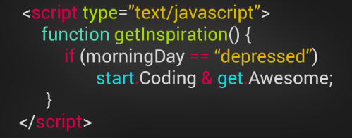
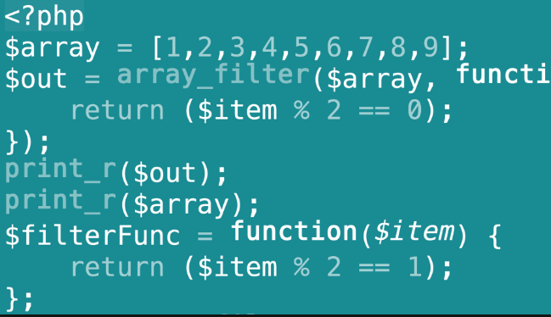


What does Scripting Language mean?
A scripting language is a programming language designed for integrating and communicating with other programming languages. A scripting language is interpreted, rather than compiled, which means that scripting languages represent a subset of all programming languages.
Scripting language is normally used in conjunction with another programming language, like HTML or Java, C++.
Dept. of CS&E, MSRIT

Slide 6
Features of Python
  Python is a general-purpose high-level programming language whose design philosophy emphasizes code readability.
  Python supports multiple programming paradigms, primarily but not limited to object oriented, imperative and, to a lesser extent, functional programming styles.
  Python aims to combine "remarkable power with very clear syntax", and its standard library is large and comprehensive.
  Its use of indentation for block delimiters is unusual among popular programming languages.
Dept. of CS&E, MSRIT

Slide 7
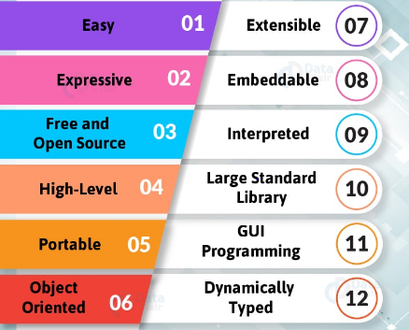
Features of Python
Dept. of CS&E, MSRIT

Slide 8
Major Versions of Python
    Python 2.0 was released on 16 October 2000, with many major new features including a full garbage collector and support for Unicode.
    Python 3.0, a major, backwards-incompatible release with Python 2.x, was released on 3 December 2008 after a long period of testing.
    Many of its major features have been backported to the backwards-compatible Python 2.7.
Dept. of CS&E, MSRIT

Slide 9
Major Versions of Python
“Python” or “CPython” is written in C/C++
- Version 2.7 came out in mid-2010
- Version 3.1.2 came out in early 2010
-version 3.4.0 came out in 2014
“Jython” is written in Java for the JVM
“IronPython” is written in C# for the .Net environment
Dept. of CS&E, MSRIT

Slide 10
Technical Strengths of Python
  It's Object-Oriented: Python is an object-oriented language, from the ground up. Its class model supports advanced notions such as polymorphism, operator overloading, and multiple inheritance.
  It's Free: Python is freeware - something which has lately been come to be called open source software.
  It's Portable: Python is written in portable ANSI C, and compiles and runs on virtually every major platform in use today.
  It's Powerful: Dynamic typing, Automatic memory management, programming-in-the-large support, Built-in object types. Built-in tools, Library utilities.
Dept. of CS&E, MSRIT

Slide 11
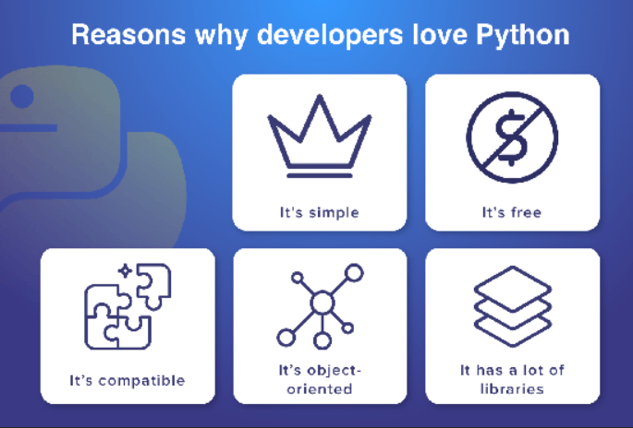
Technical Strengths of Python
  It's Mixable: Python programs can be easily "glued" to components written in other languages.
  It's Easy to Use: as with other interpreted languages, Python executes programs immediately, which makes for both an interactive programming experience and rapid turnaround after program changes.
Dept. of CS&E, MSRIT

Slide 12
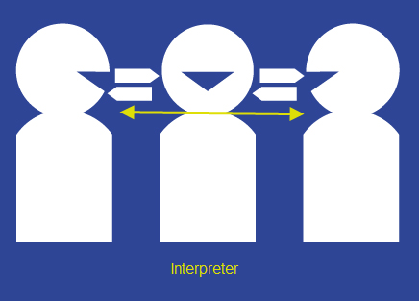
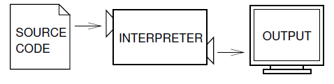
Development Environment of Python
  Python2.7/3.5
    It is an interpreter which reads a high-level program and executes it, and processes the program a little at a time (statement by statement).
Dept. of CS&E, MSRIT

Slide 13
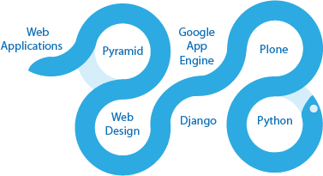
What can I do with Python?
  Data Analysis and Plotting
  GUIs
  Make a website
  Database Programming
  Rapid Prototyping
  Numeric and Scientific Programming
  Natural Language
  Make and remix music
  Analyze census data!
  Games, Images, AI, XML and more
Dept. of CS&E, MSRIT

Slide 14
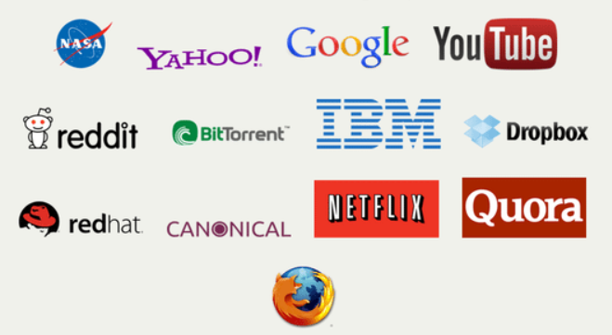
Who Uses Python Today?
Google and Yahoo currently use Python in Internet service
Intel, Cisco, Hewlett-Packard, Seagate, Qualcomm, and IBM use Python for hardware testing.
Industrial Light and Magic use Python in the production of movie animation
The YouTube video sharing service is largely written in Python.
The NSA uses Python for cryptography and intelligence analysis.
For more details, visit www.python.org
Dept. of CS&E, MSRIT

Slide 15
Comparison with other languages
C Program | Java Program | Python Program
main() { printf("hello, world\n"); } | class myfirstjavaprog { public static void main(String args[]) { System.out.println("Hello World!"); } } | print (“Hello World!!”)
Dept. of CS&E, MSRIT

Slide 16
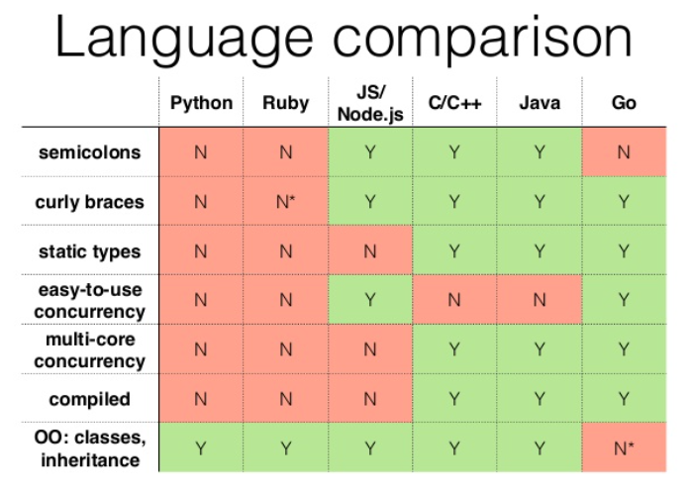
Comparison with other languages
Dept. of CS&E, MSRIT

Slide 17
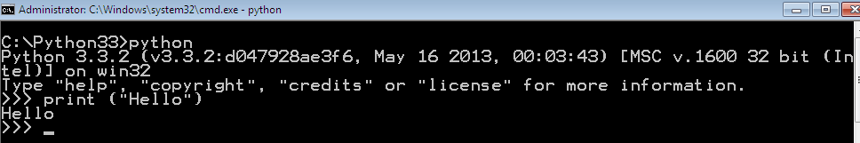
First Python Program
Dept. of CS&E, MSRIT

Slide 18
Python Basics: Numbers
Numbers
Decimal | 631, 3.14
Octal | O631
Hexadecimal | 0xABC
Complex | 1+3j
Integer division can change type, e.g. 5 / 2 = 2.5
int(x) converts x to an integer : e.g int(2.0)=2
float(x) converts x to a floating point
e.g float(2) = 2.0
Dept. of CS&E, MSRIT

Slide 19
Python Basics: Strings
Strings are immutable
There is no char type like in C++ or Java
Can use single or double quotes, and three double quotes for a multi-line string
String operation | Usage
Concatenation | Hello” + “World” -> “HelloWorld”
Repetition | “UMBC” * 3 -> “UMBCUMBCUMBC”
Indexing | “UMBC”[0] -> “U
Slicing | “UMBC”[1:3] -> “MB”
Size | len(“UMBC”) -> 4
Comparison | “UMBC” < “umbc” -> 0
Search | “M” in “UMBC” -> 1
Dept. of CS&E, MSRIT

Slide 20
Python Basics: Strings
>>> 'I am a string'
'I am a string'
>>> "So am I!"
'So am I!'
>>> """And me too!
... though I am much longer
... than the others :)"""
'And me too!\nthough I am much longer\nthan the others :)'
H
e
l
l
o
B
o
b
0 1 2 3 4 5 6 7 8
>>> greet = "Hello Bob"
>>> greet[0]
'H'
>>> print(greet[0], greet[2], greet[4])
H l o
>>> x = 8
>>> print(greet[x - 2])
B
Dept. of CS&E, MSRIT

Slide 21
Arithmetic and Comparison Operators
Operator | Description | Example
+, - | Addition, Subtraction | 10 -3
*, % | Multiplication, Modulo | 27 % 7 Result: 6
/ | Division | 10/3 3.333333
// | Truncation Division (also known as floor division) The result of the division is truncated to an integer. Works for integers and floating-point numbers as well | 27 // 7 Result: 3
+x, -x | Unary minus and Unary plus (Algebraic signs) | -3
~x | Bitwise negation | ~3 - 4 Result: -8
** | Exponentiation | 10 ** 3 Result: 1000
or, and, not | Boolean Or, Boolean And, Boolean Not | (a or b) and c
in | "Element of" | 1 in [3, 2, 1]
<, <=, >, >=, !=, == | The usual comparison operators | 2 <= 3
|, &, ^ | Bitwise Or, Bitwise And, Bitwise XOR | 6 ^ 3
<<, >> | Shift Operator | 6 << 3
Dept. of CS&E, MSRIT

Slide 22

Python program structure
Indentation
White space at the beginning of the line is important, is called indentation.
Leading whitespace (spaces and tabs) at the beginning of the logical line (which understand by python) is used to determine the indentation level of the logical line, which in turn is used to determine the grouping of statements.
Do not use a mixture of tabs and spaces for the indentation.
It is strongly recommend that use a single tab or four spaces.
The ‘#’ starts a line comment
Dept. of CS&E, MSRIT

Slide 23
Look at a sample of code…
x = 34 - 23 # A comment.
y = “Hello” # Another one.
z = 3.45
if z == 3.45 or y == “Hello”:
x = x + 1
y = y + “ World” # String concat.
print (x)
print (y)
Dept. of CS&E, MSRIT

Slide 24


Variables
A variable is a name (identifier) that is associated with a value
Dept. of CS&E, MSRIT

Slide 25
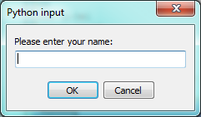
Input
There is a built-in function in Python for getting input from the user:
n = input("Please enter your name: ")
Dept. of CS&E, MSRIT

Slide 26
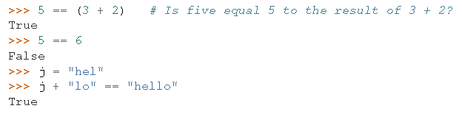
Boolean values and expressions
A Boolean value is either true or false.
In Python, the two Boolean values are True and False.
>>> type(True)
<class ’bool’>
>>> type(true)
Traceback (most recent call last):
File "<interactive input>", line 1, in <module>
NameError: name ’true’ is not defined
Dept. of CS&E, MSRIT

Slide 27
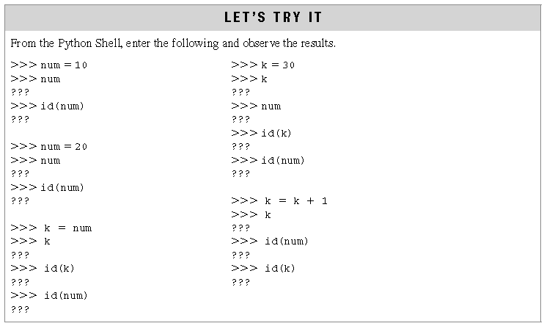
Variables Example
Dept. of CS&E, MSRIT

Slide 28
Example Python Programs
Hello World.
Input data from user
Data types and printing.
Calculating gross pay
Compute Compound interest
Dept. of CS&E, MSRIT

Slide 29
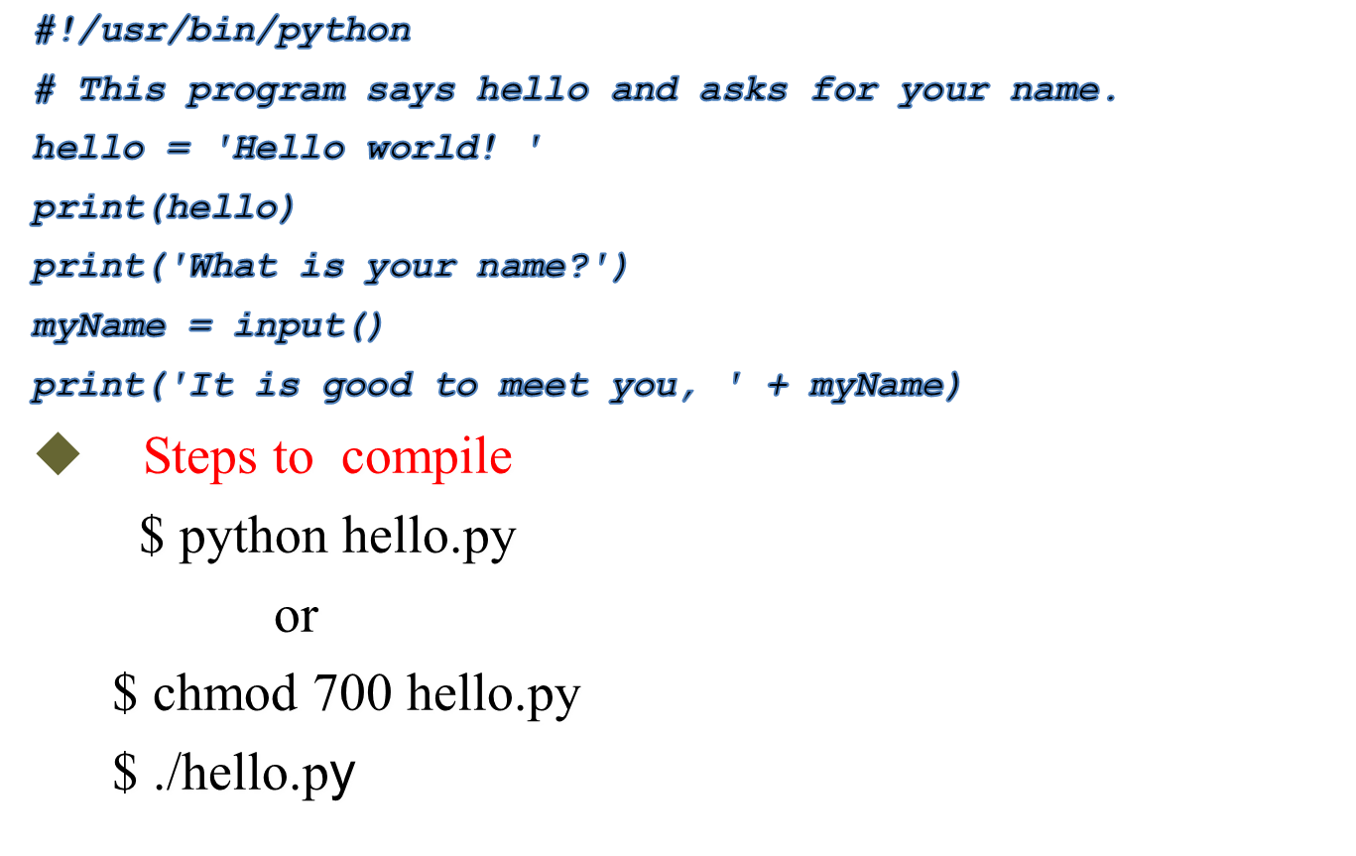
Our first program
Dept. of CS&E, MSRIT

Slide 30
Conclusion: Python is ..
Popular as a scripting language
Popular as a general purpose language Open sourced
Interesting from a program language perspective
Dept. of CS&E, MSRIT

Slide 31
Exercises
Write a Python program that allows the user to enter two integer values, and displays the results when each of the following arithmetic operators are applied. For example, if the user enters the values 7 and 5, the output would be,
    7 + 5 = 12
    7 - 5 = 2
    7 * 5 = 35
    7 / 5 = 1.40
    7 // 5 = 1
    7 % 5 = 2
    7 ** 5 = 16,807
Dept. of CS&E, MSRIT

Slide 32
Exercises
Write a Python program that allows the user to enter any integer value, and displays the value of 2 raised to that power.
  Your program should function as shown below.
    What power of two? 10
    Two to the power of 10 is 1024
Write a Python program that allows the user to enter any integer base and integer exponent, and displays the value of the base raised to that exponent.
  Your program should function as shown below.
      What base? 10
      What power of 10 ? 4
      10 to the power of 4 is 10000
      3. Write a python program that asks the user how many coins of various types they have, and then prints the total amount of money in rupees.
Dept. of CS&E, MSRIT

